Slide 1
iSchool Q&A bot: cohere and pinecone
by Sahil Wani

Slide 2
Introduction
This presentation outlines the creation of a Q&A bot. The bot uses Syracuse University iSchool’s graduate course information. It leverages Pinecone and Cohere for enhanced knowledge retrieval.

Slide 3
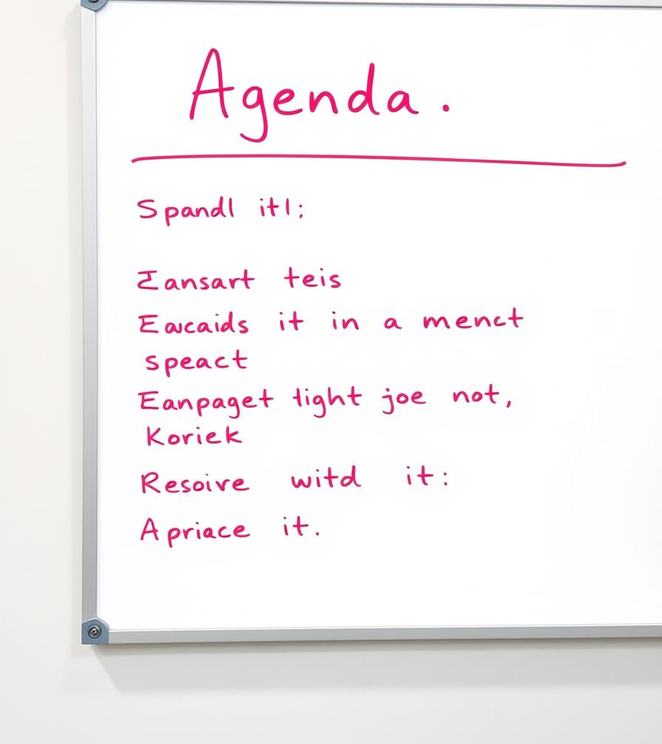
Agenda
Core components
Requirements and tools
Why Vector Databases
Creating Vector Databases
Generating Embeddings
Uploading Embeddings to Pinecone
Querying the Vector Database
LLM Integration
Chatbot Architecture Overview
Output

Slide 4
Core Components
Pinecone : Stores and manages vector embeddings
Embeddings: Sentence transformers in vector database
LLM: Cohere API
Chat UI: Streamlit
Course data: Syracuse University iSchool graduate courses description

Slide 5
Requirement and Tools
Requirements:
Ability to answer detailed questions on iSchool's graduate courses
Must handle quires about course information, credits, description etc.
Tools Used:
Python
Cohere
Streamlit
Sentence Transformers

Slide 6
Why Vector Databases
Semantic Search
Retrieves information based on meaning.
Scalability
Efficiently handles large datasets.
Pinecone Benefits
Managed service, easy integration.

Slide 7
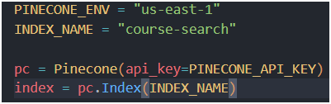
Creating Vector database
Account Setup
Sign up on pinecone.io
Retrieve API key & environment
Initialize the Pinecone

Slide 8
generating Embeddings
Model Selection: sentence-transformers (all-MiniLM-L6-v2)
Embedding Process:
Install dependencies
pip install sentence-transformers
Generate vector embeddings for each course description
Store results as 384-dim vectors
Why sentence-transformers?
Good balance of speed & accuracy for Q&A tasks

Slide 9
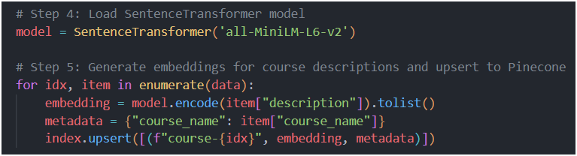
Uploading embeddings to pinecone
Convert each description into an embedding
Upsert into Pinecone with metadata (course name, ID, etc.)
Each course is stored as a vector, enabling similarity search

Slide 10
Querying the vector database
How it Works:
Convert user query into an embedding
Pinecone returns the top matching course entries
Metadata (course descriptions) are then passed to Cohere

Slide 11
LLm Integration
Why Cohere?
Capable of generating high-quality, context-aware answers
Process
Retrieve the top course data from Pinecone
Build a prompt with the relevant course descriptions
Send the prompt to Cohere for the final, natural language response

Slide 12
Chatbot Architecture Overview
User Query
↓
Embed Query (Sentence-Transformers)
↓
Search Pinecone for Similar Courses
↓
Relevant Course Data
↓
Prompt Construction → Cohere LLM → Generate Answer
↓
Return Answer to User in Streamlit UI

Slide 13
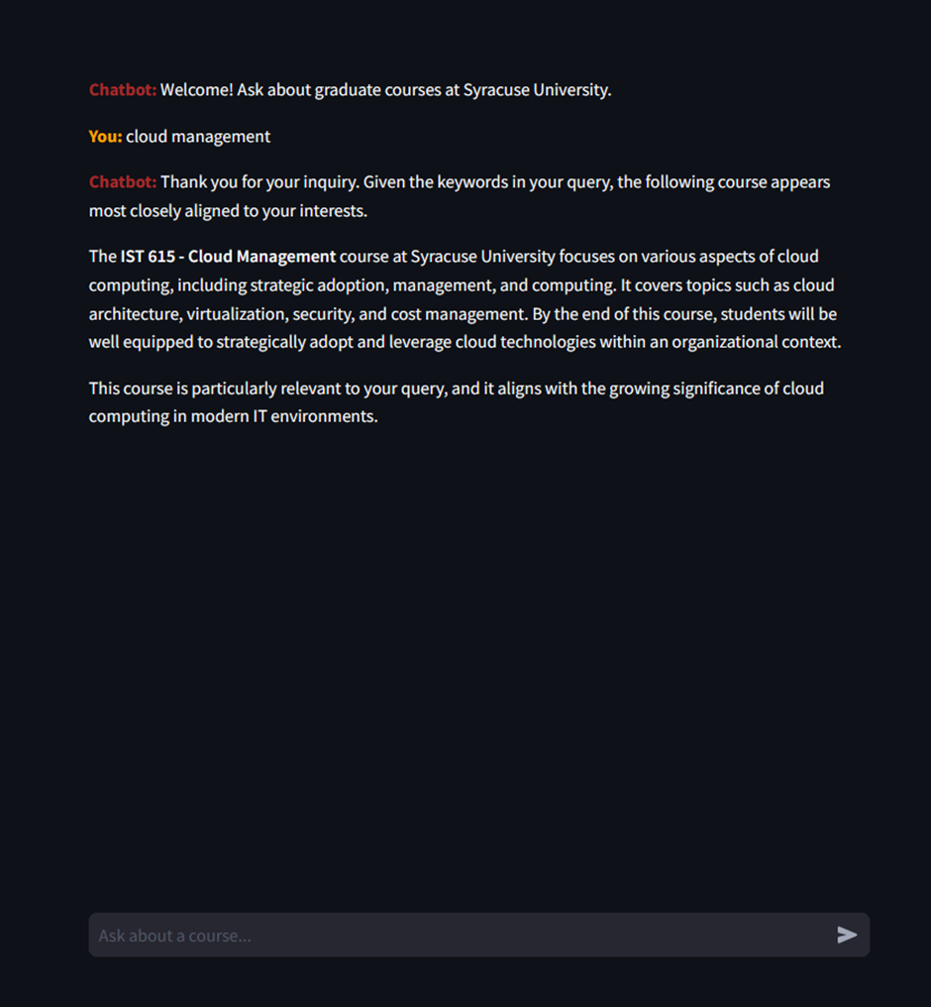
Output

Slide 14

Thank you

